Slide 1
Network visualization and automation
Network visualization and automation
EuroPython 2017
EuroPython 2017 - Rimini

Slide 2
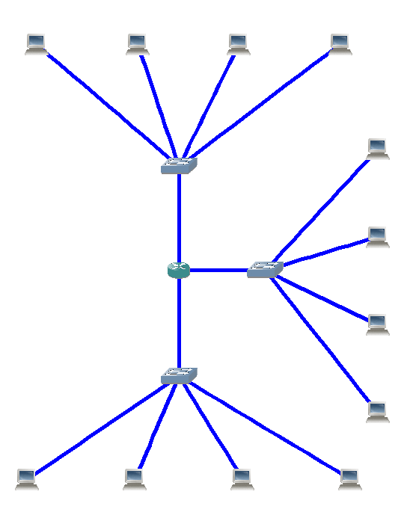
Telecommunication network :
Networking devices
Transmission links

Slide 3



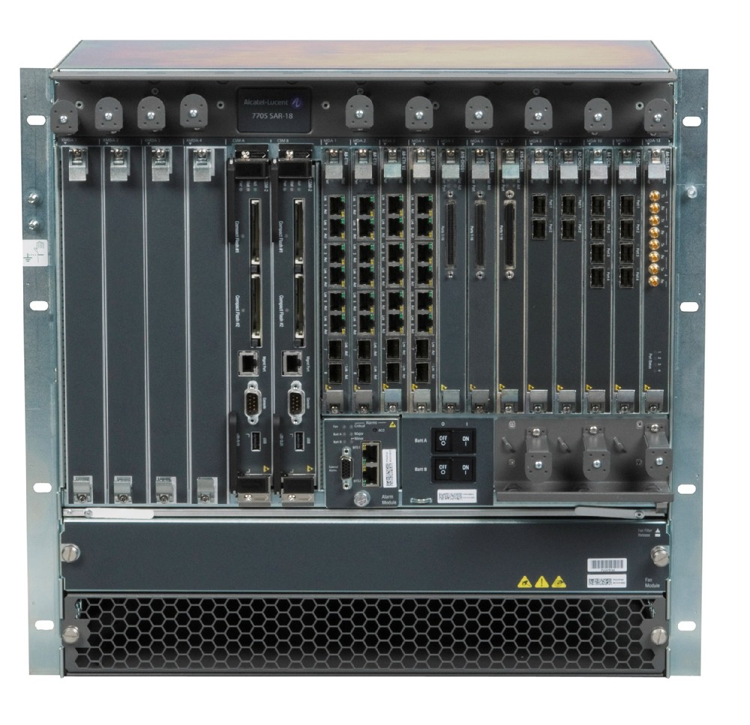
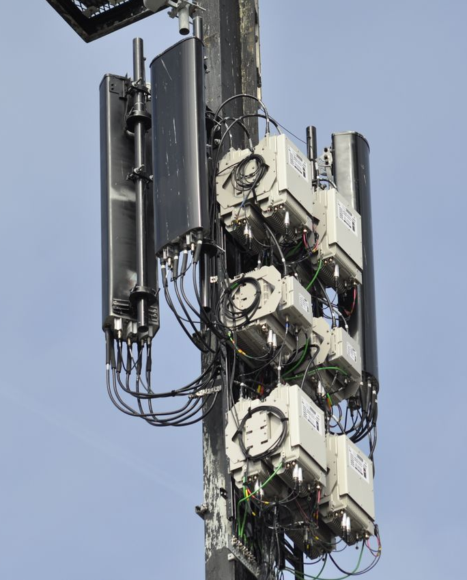
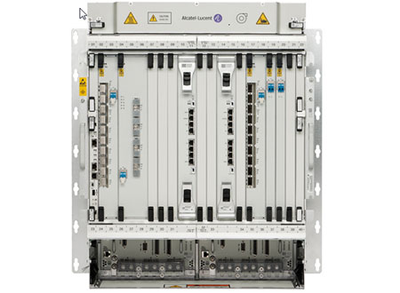
Nokia 7705 SAR
Nokia 1830 PSS
Nokia antenna
ROUTER
OPTICAL SWITCH
ANTENNA

Slide 4

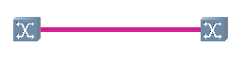

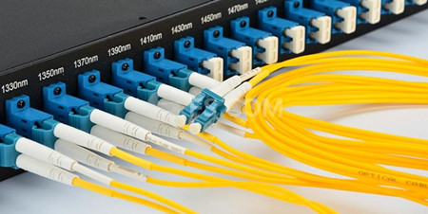
Ethernet (10G)
Optical fiber

Slide 5
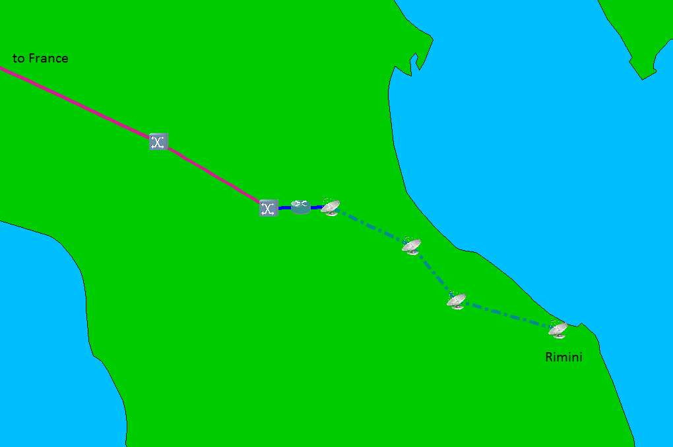
Router :
Look at the destination IP
Search for the IP in it’s routing table
Make a forwarding decision
Microwave transmission between antennas
Optical switch :
Converts the electrical signal to an optical signal
Sends the signal on an optical fiber
Notes:
Once the data reaches the antenna located in Bologna, the microwave signal is converted to an electrical signal and sent to a router (most likely colocated, in the same building).
The router has what we call a routing table that tells him how to forward the information it receives, based on the destination. (table lookup)
A routing table is basically an table that tells a router on which interface it should send the data depending on the destination.

Slide 6
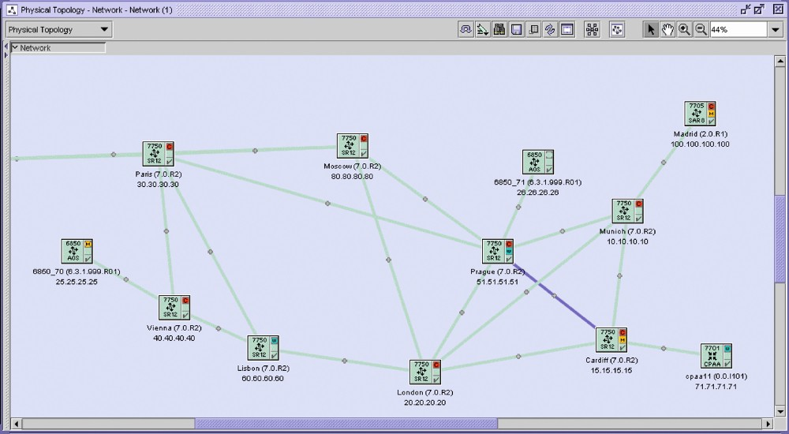
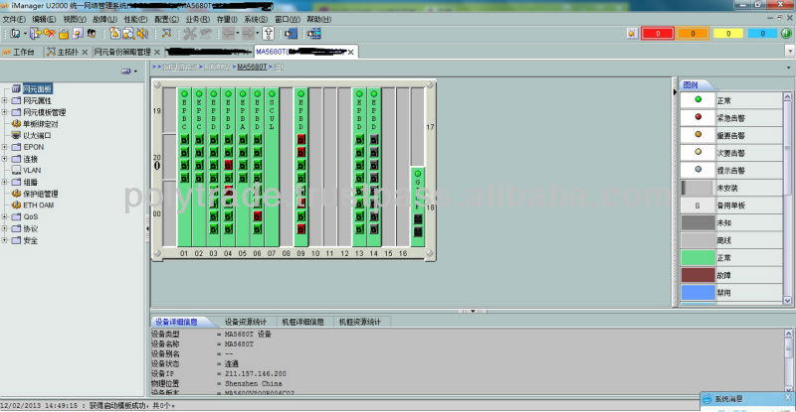
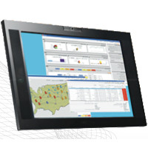
5620 SAM (Nokia)
Network Management System (NMS) are provided by equipment manufacturers :
Network visualization
Network inventory
Network provisioning
Network supervision
U2000 (Huawei)
OneControl (Ciena)
Notes:
A company that sells networking devices like Cisco, Juniper, Nokia, etc usually provides a Network Management System.
It is a software that has an overview of the network's devices and that is used for many different things, mainly for monitoring.
The first step to visualization is to have a file that contains the topology of our network, nodes + links.
In order to create such a file, we can send queries to the NMS to ask them what they see, and organize that information in a csv/xls/txt.

Slide 7
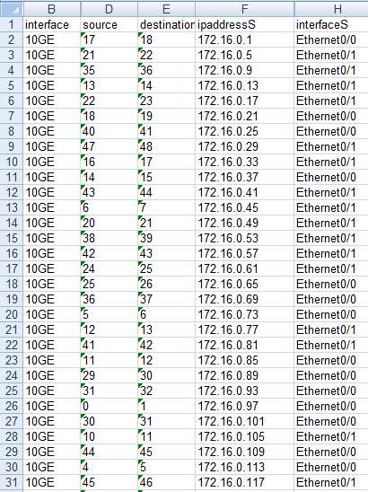
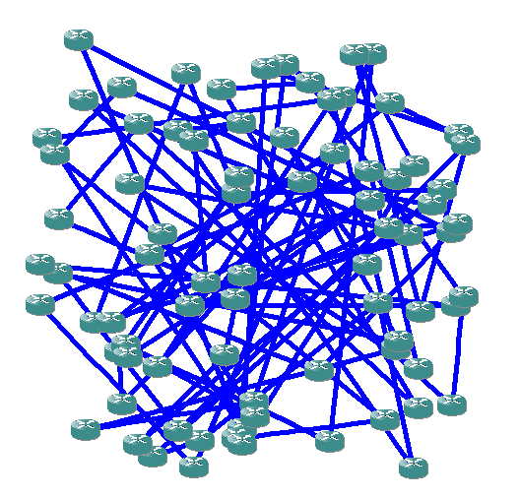
Network topology
Drawing of the associated network

Slide 8
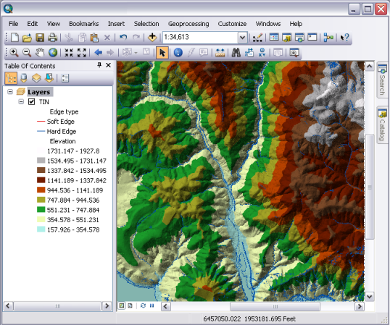
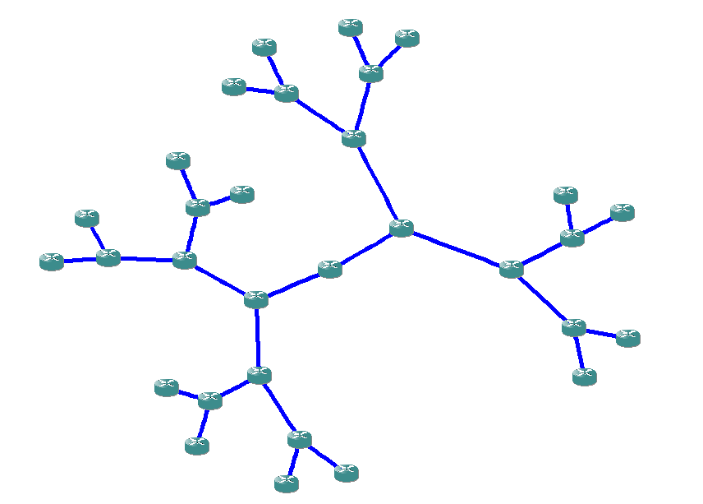
GPS coordinates
Drawing algorithm

Slide 9


We need :
A GUI programming toolkit (tkinter)
A widget for low-level drawing (Canvas)
A method to draw polygons

Slide 10


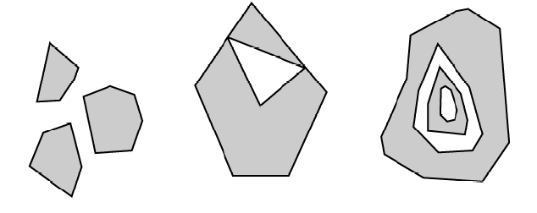
Polygons
Multipolygons
Shapefile (.shp)

Slide 11
Shapes extraction
shapefile module
(pyshp)
Shapefile (.shp)

Slide 12
Extract the polygons of a multipolygon
shapely module
Polygons and multipolygons
Polygons only

Slide 13
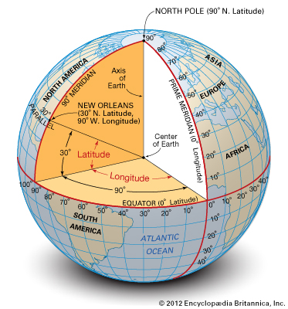
Shapefile uses the WGS-84 geographic system
Point on the earth
(longitude, latitude)

Slide 14
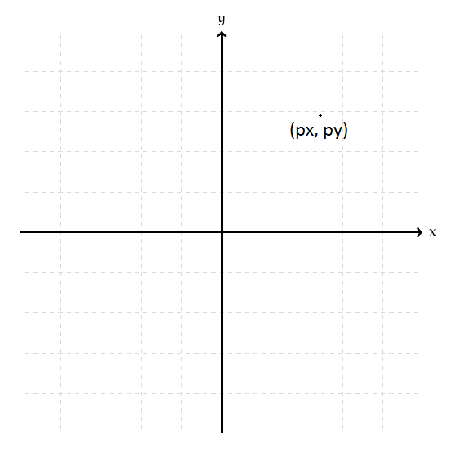
3D to 2D conversion
Point on the earth (3D) (longitude, latitude)
Point on a plan (2D)
(projected x, projected y)
Consequence of the « Remarkable theorem » (Gauss) :
Every carthographic projection causes a distortion

Slide 15
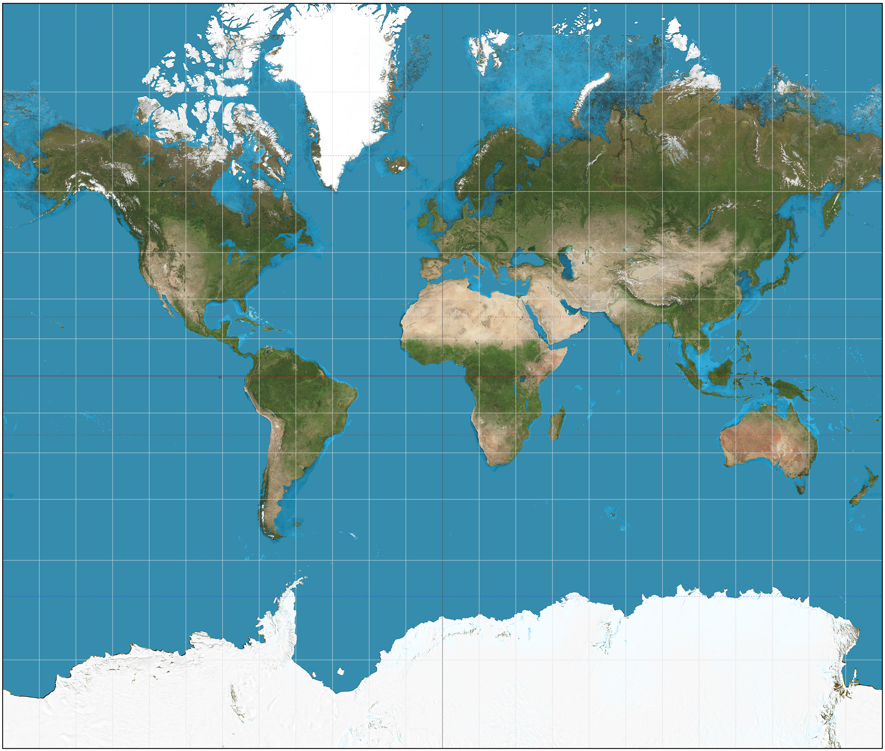

Creating a GIS software
Convert geographic coordinates into projected coordinates :
pyproj
Mercator
Azimuthal orthographic

Slide 16
Creating a GIS software
We need :
A GUI programming toolkit (tkinter)
A widget to create polygons (tkinter’s Canvas)
A file that contains the map coordinates (shapefile)
A library to read shapefiles (pyshp)
A library to convert multipolygons into polygons (shapely)
A library to convert geographic coordinates into projected coordinates (pyproj)

Slide 17
Network automation landscape
Netmiko
SSH/Telnet
Paramiko
Exscript
NETCONF/YANG (multi-vendor, IETF)
Network programmability using YANG / NETCONF
Vendor-specific solution (API)
Puppet
Chef
Configuration management tools
Ansible (SSH)
…

Slide 18
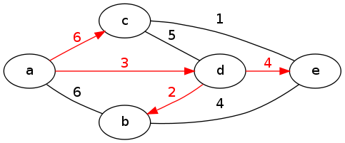
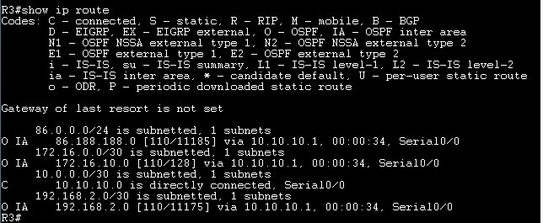
IP routing
Protocols are used for routers to exchange information about the network topology. Routers then use algorithms to find the shortest path to other routers.
OSPF
Run Dijkstra’s algorithm to find the Shortest Path Tree
Create the routing table: (destination outgoing interface)

Slide 19
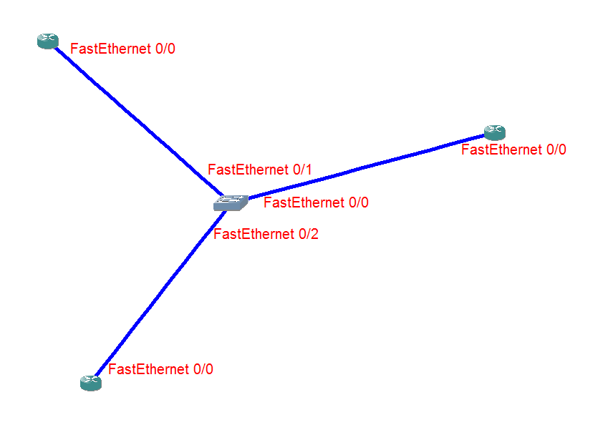
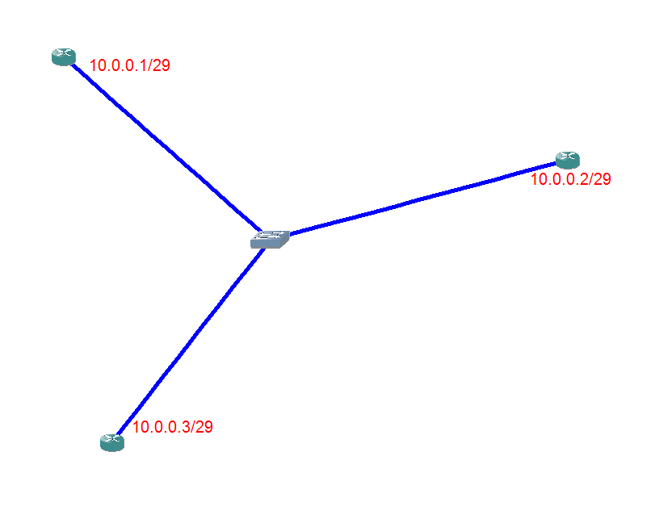
Simulation of an OSPF network
Allocate names to all interfaces
Allocate IP addresses to all interfaces
1
2

Slide 20
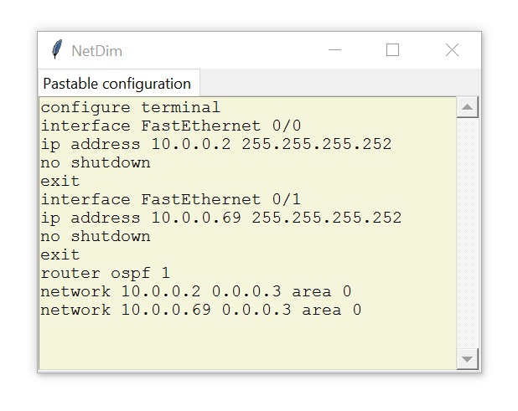
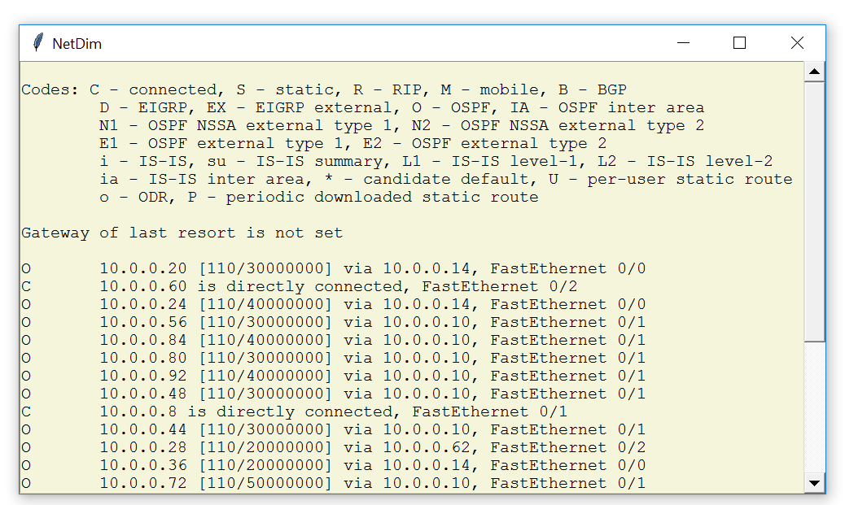
Simulation of an OSPF network
Generate the configuration
Create of the routing tables
3
4

Slide 21


Use Dynamips to emulate Cisco iOS
Uses a lot of RAM/CPU (not scalable, up to 50 devices maximum)
Useful to prepare Cisco certifications and test complex configuration
Use algorithms to (try to) reproduce the way network devices work
Scalable (~ 50000 devices)
Useful for network capacity planning & optimization

Slide 22
https://github.com/afourmy/pyNMS
https://github.com/afourmy/pyGISS
https://github.com/afourmy/EuroPython-2017
https://github.com/Toblerity/Shapely
https://github.com/jswhit/pyproj
https://github.com/knipknap/exscript
https://github.com/ktbyers/netmiko
https://github.com/ansible/ansible
Thank you

